Slide 1
24
7
30
Date
Ratio Review
EQ – What is a ratio and how is it used?
What is a ratio?
Ratios are used to compare quantities with the same units.
The ratio of 2 to 5 is written as 2 : 5
How is a ratio used?
If you are making cordial and you mix one part cordial to four parts water, then the ratio of cordial to water will be 1:4 (1 to 4).
If you use 1L of cordial, you will use 4L of water (1:4).
If you use 2L of cordial, you will use 8L of water (2:8).
If you use 10L of cordial, you will use 40L of water (10:40).
What are equivalent ratios?
Similar to equivalent fractions: if simplified they will be the same
These ratios are all equivalent 1:4 = 2:8 = 10:40

Slide 2
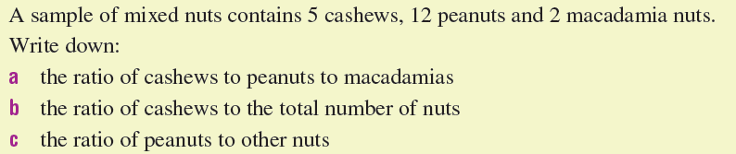
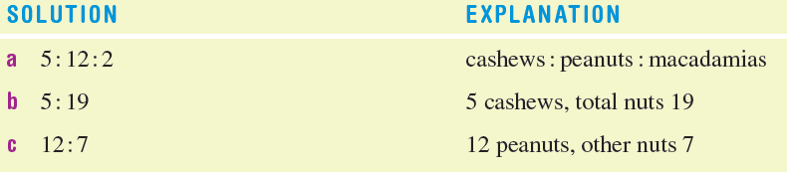
For example…

Slide 3

Do you understand? Fists of Five
Notes:
Check for Understanding

Slide 4
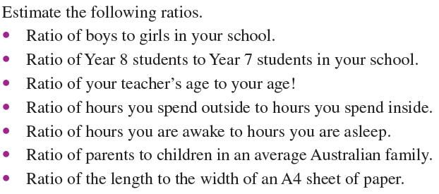

Let’s have a try together

Slide 5


NAPLAN WS
9 questions ~ 11 min
End
Click for timer to start

Slide 6
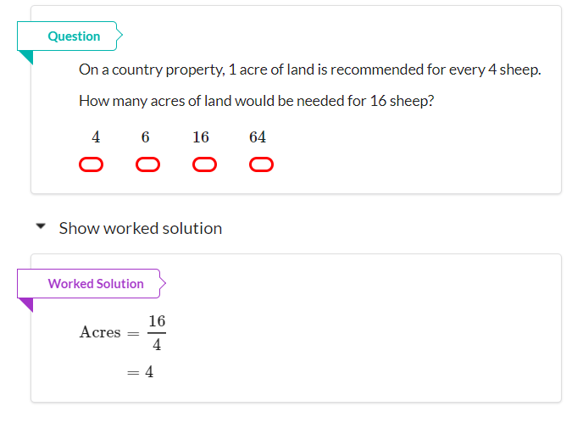
Question 1 – Band 6

Slide 7
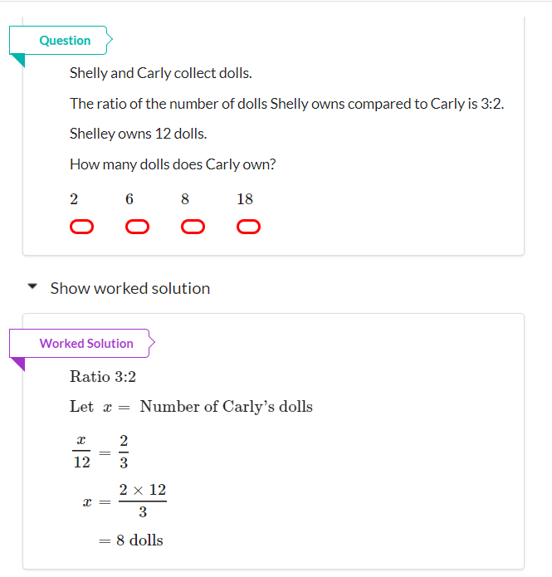
Question 2 Band 6

Slide 8
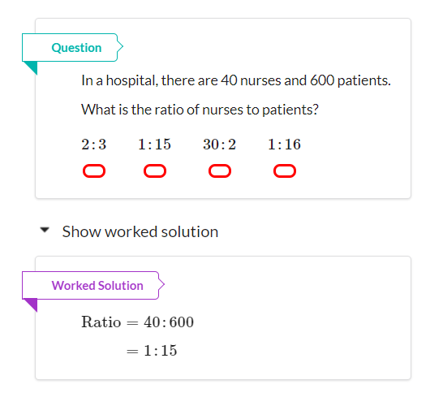
Question 3 Band 7

Slide 9
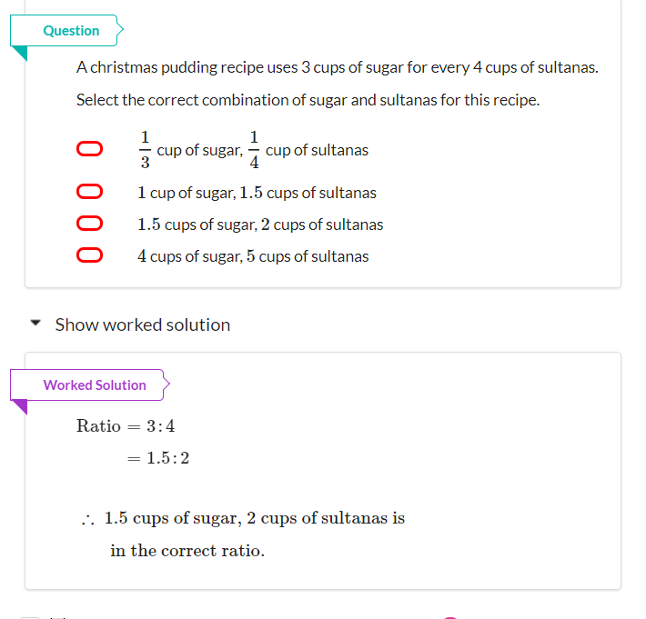
Question 4 Band 8

Slide 10
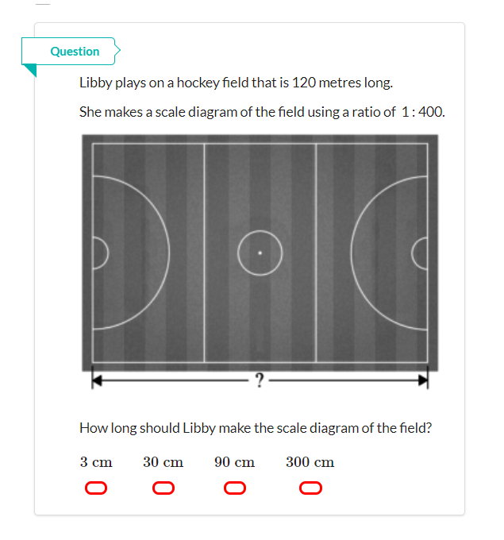
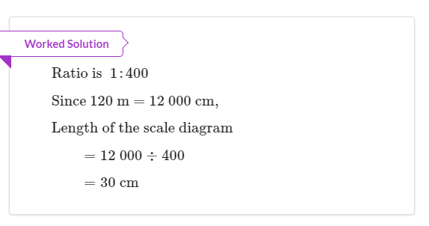
Question 5 – Band 8

Slide 11
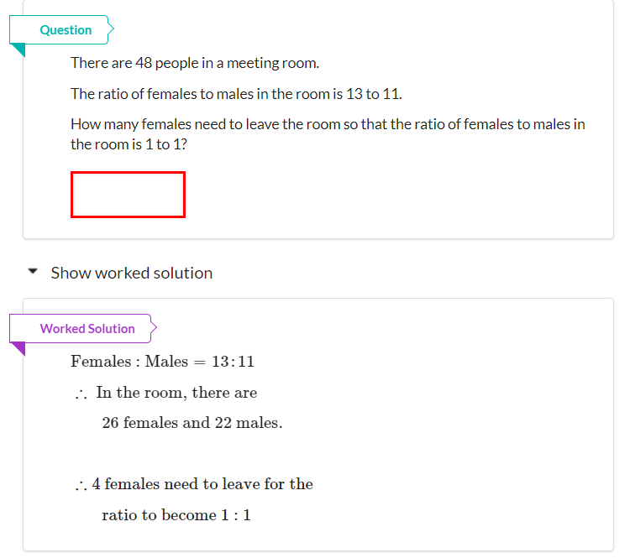
Question 6 Band 9

Slide 12
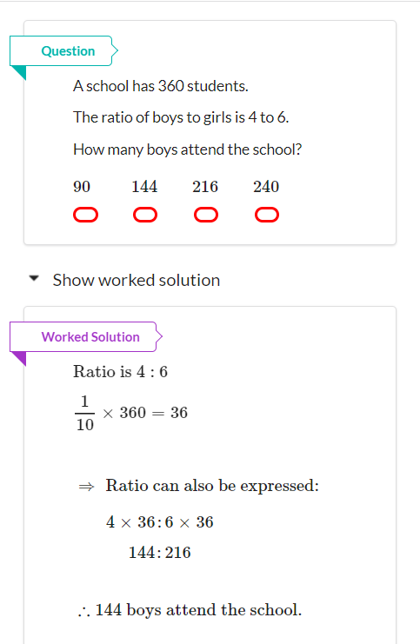
Question 7 Band 10

Slide 13
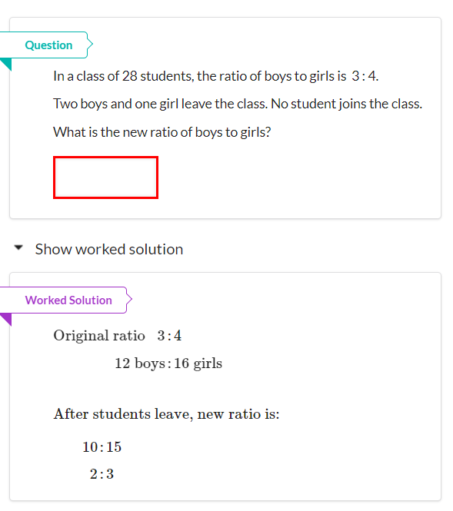
Question 8 Band 10

Slide 14
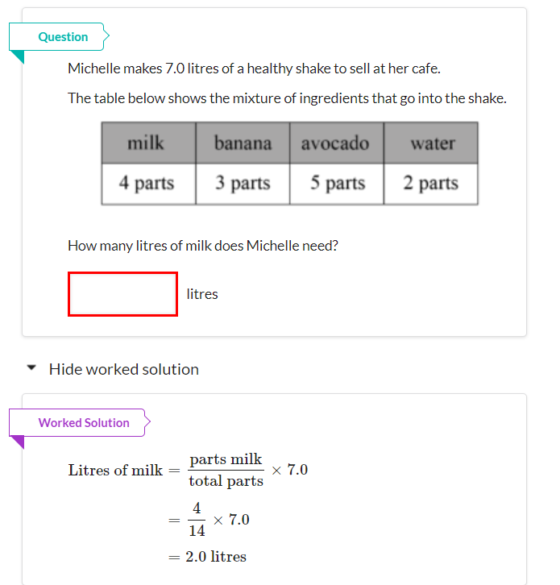
Question 9 Band 10

